Slide 1
Automatic Smear Detection
Amar Shah, Randall Harris, Sonia Nigam

Slide 2
Process: First Step - Canny Edge
Our first step was to find the edges for each picture we selected.
Canny - The function takes in a color image and two threshold values and returns your image in black and white with outlined edges (Intermediate).
The max and min threshold values are used for finding initial segments of strong edges and edge linking, respectively. We realized that smaller values would increase the precision of outlining solely the mask. We decided 50 and 135 produced the best outcome.

Slide 3
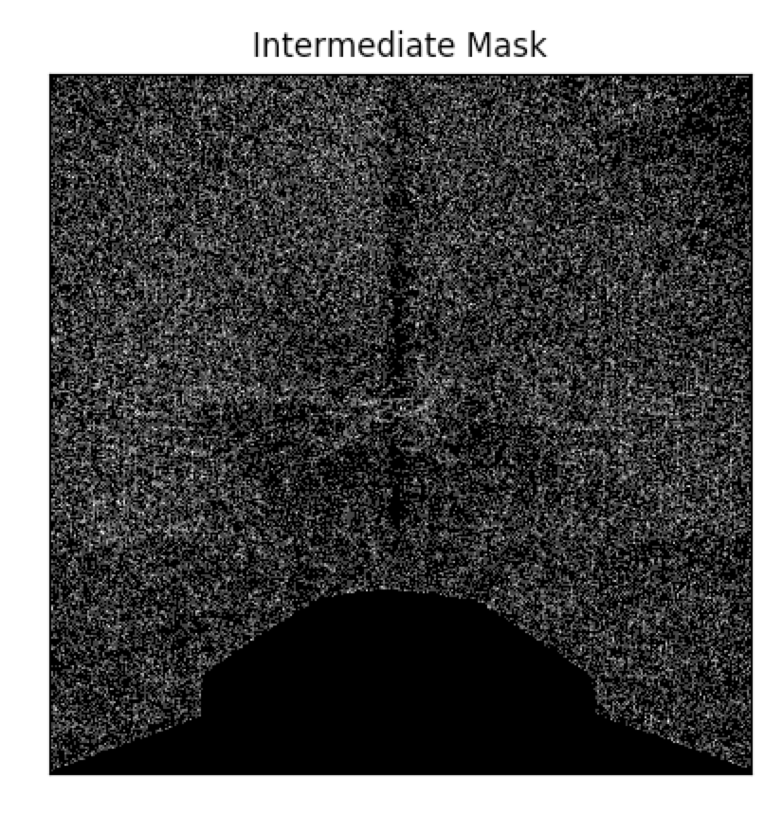
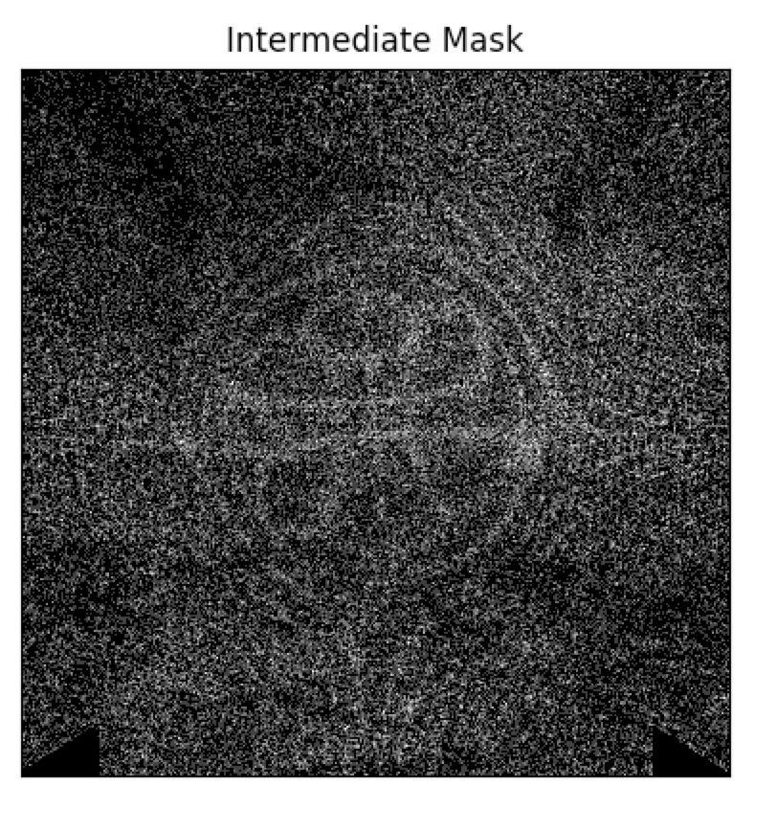
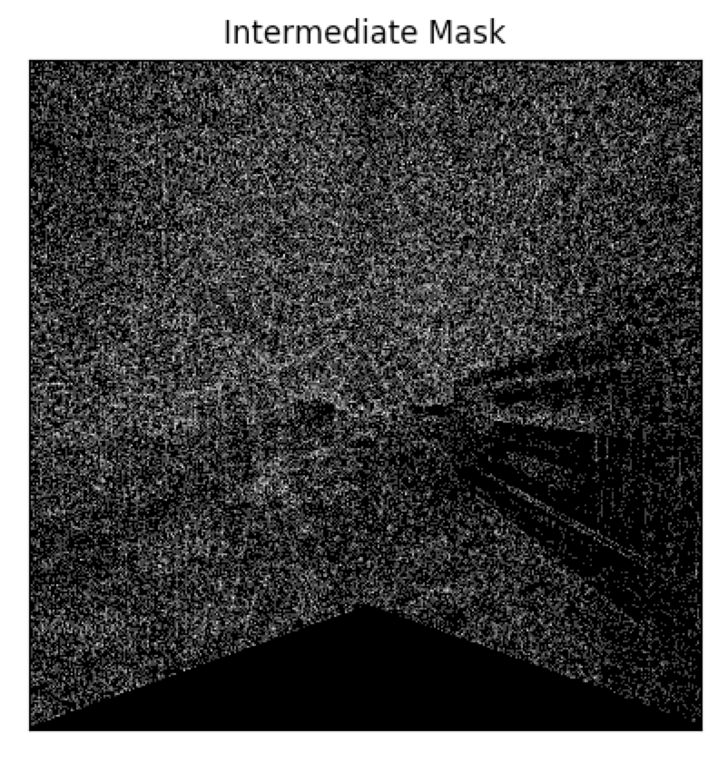
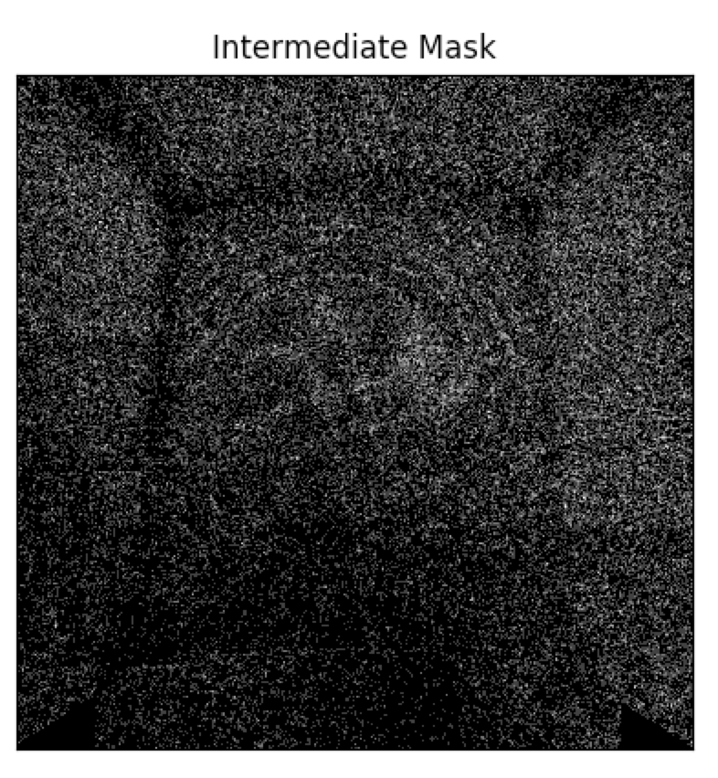
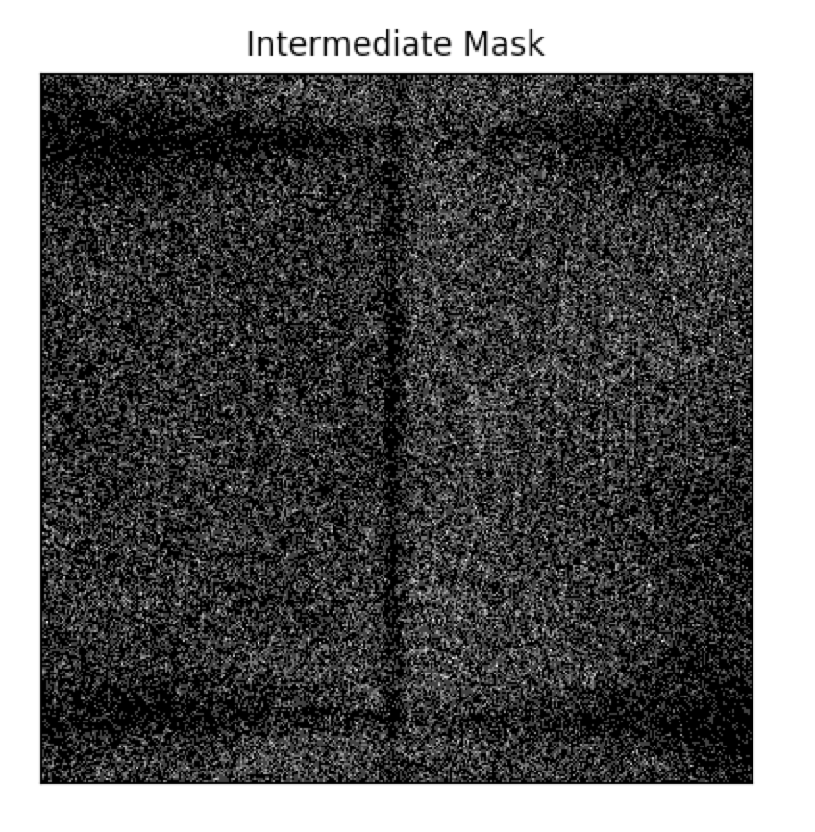
Intermediate Results
camera 0
camera 1
camera 2
camera 3
camera 5

Slide 4
Process: Middle Step - Gaussian Filter/Median Blur
Median Blur - This function smoothes out an image using the median filter with a k*k aperture. Each channel of a multi-channel image is processed independently.
Gaussian Filter - A type of Smoothing Filter. This function applies a filter to an image based on certain weights according to the Gaussian distribution.
The purpose of the Gaussian Filter and Median Blur Filter was to essentially smooth the image out. By accounting for noise, our final step was more effective in discerning the smears.

Slide 5
Process: Final Step - Binary Image Thresholding
The final step in our process was to implement Binary Image Thresholding to transform the mask into an opaque black and white image.
If the pixel value within the image was greater than 1 (our threshold), then the value would be reassigned as white. If not, the value would be reassigned as black.
This ultimately allowed us to output the final image as a version of solid black and white, rather than a collection of concentrated white and black dots, as in our intermediate steps.

Slide 6
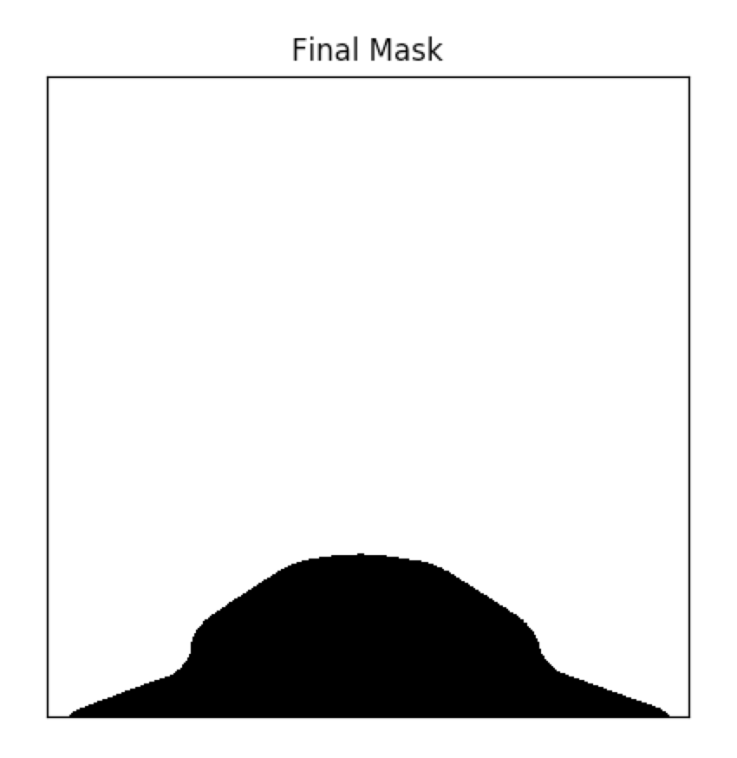
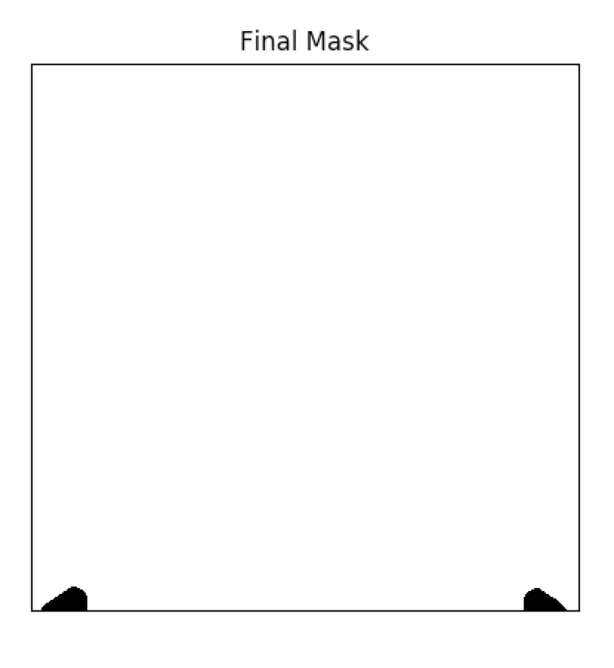
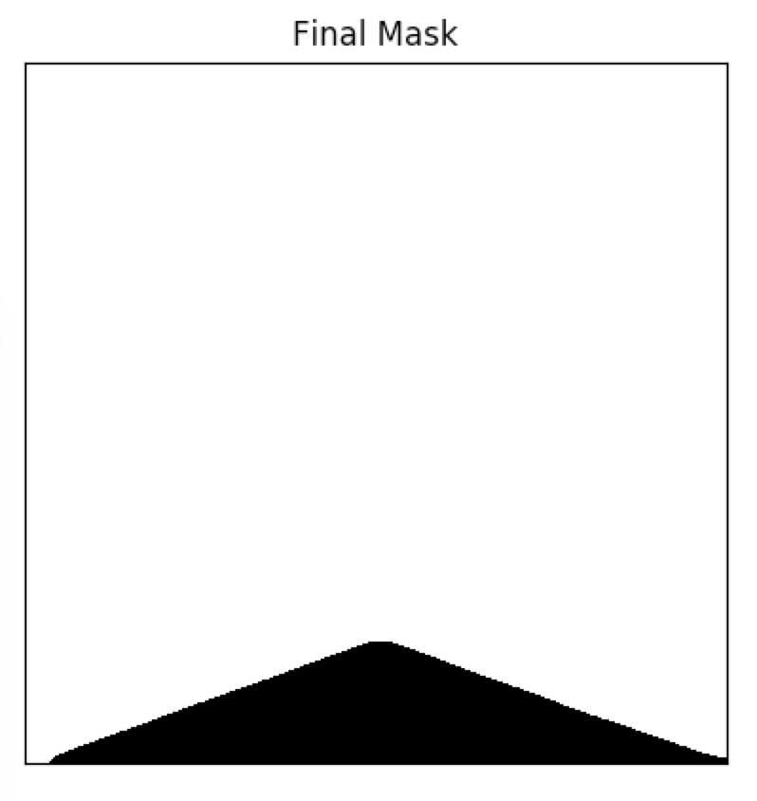
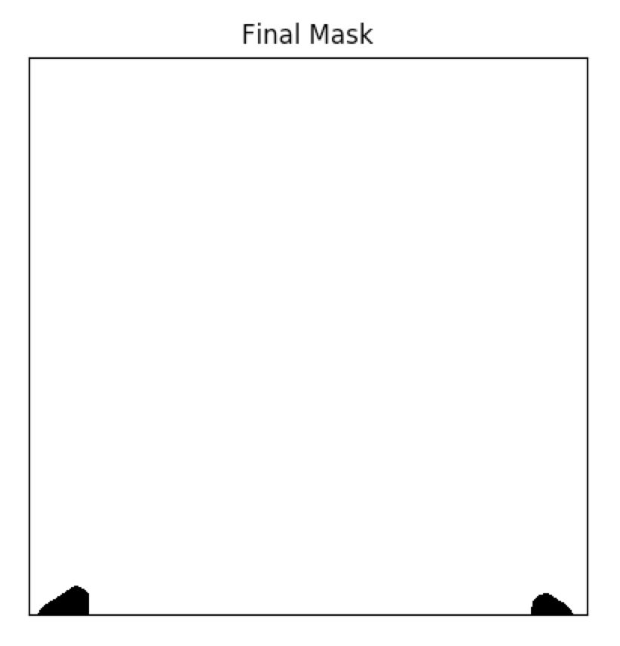
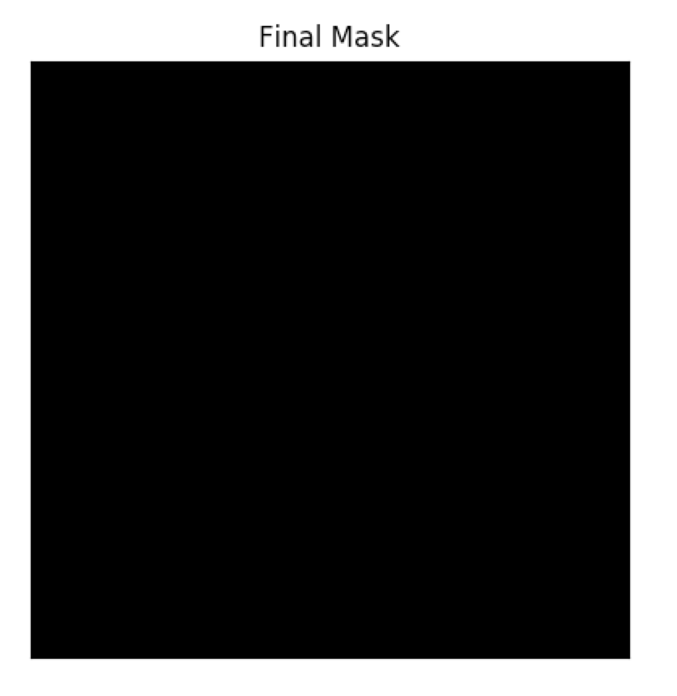
Final Results
camera 0
camera 1
camera 2
camera 3
camera 5

